Slide 1
Analysis on CREDIT Data
UNDER THE GUIDANCE OF Gaurav MISHRA SIR
BY
` SHAIK AAYESHA MOHAMMADI

Slide 2
TABLE OF CONTENTS
INTRODUCTION
DATA OVERVIEW
EXPLORATORY DATA ANALYSIS (EDA)
HYPOTHESES
ANALYSIS OF HYPOTHESES
INSIGHTS
ADVANTAGES AND DISADVANTAGES
APPLICATIONS
CONCLUSION

Slide 3
1.INTRODUCTION
Problem Statement: Gold Atlantis faces growing defaulters, risking financial stability.
Context:
Credit industry challenge: Balancing approval and risk.
Loans to potential defaulters lead to substantial losses.
Need of the Study:
Address the rise in defaulters.
Reduce financial losses
Enhance decision-making
Optimize business growth
Business Objective:
Achieve a balance between growth and stability.
Identify low-risk customers for informed credit decisions.

Slide 4
2. DATA OVERVIEW
Dataset Description: The dataset comprises credit-related data with 100,000 rows and 24 columns, with some missing values.
Data Size and Missing Values: The dataset contains 100,000 rows and 24 columns. Some columns have missing values.

Slide 5
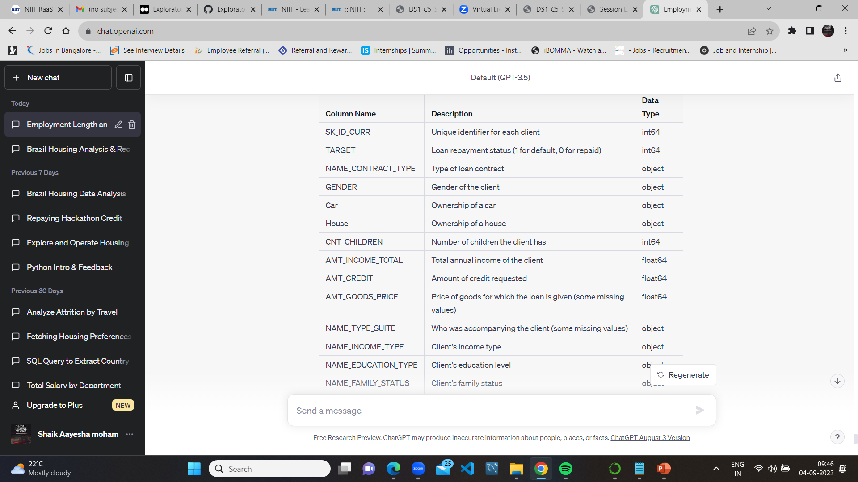
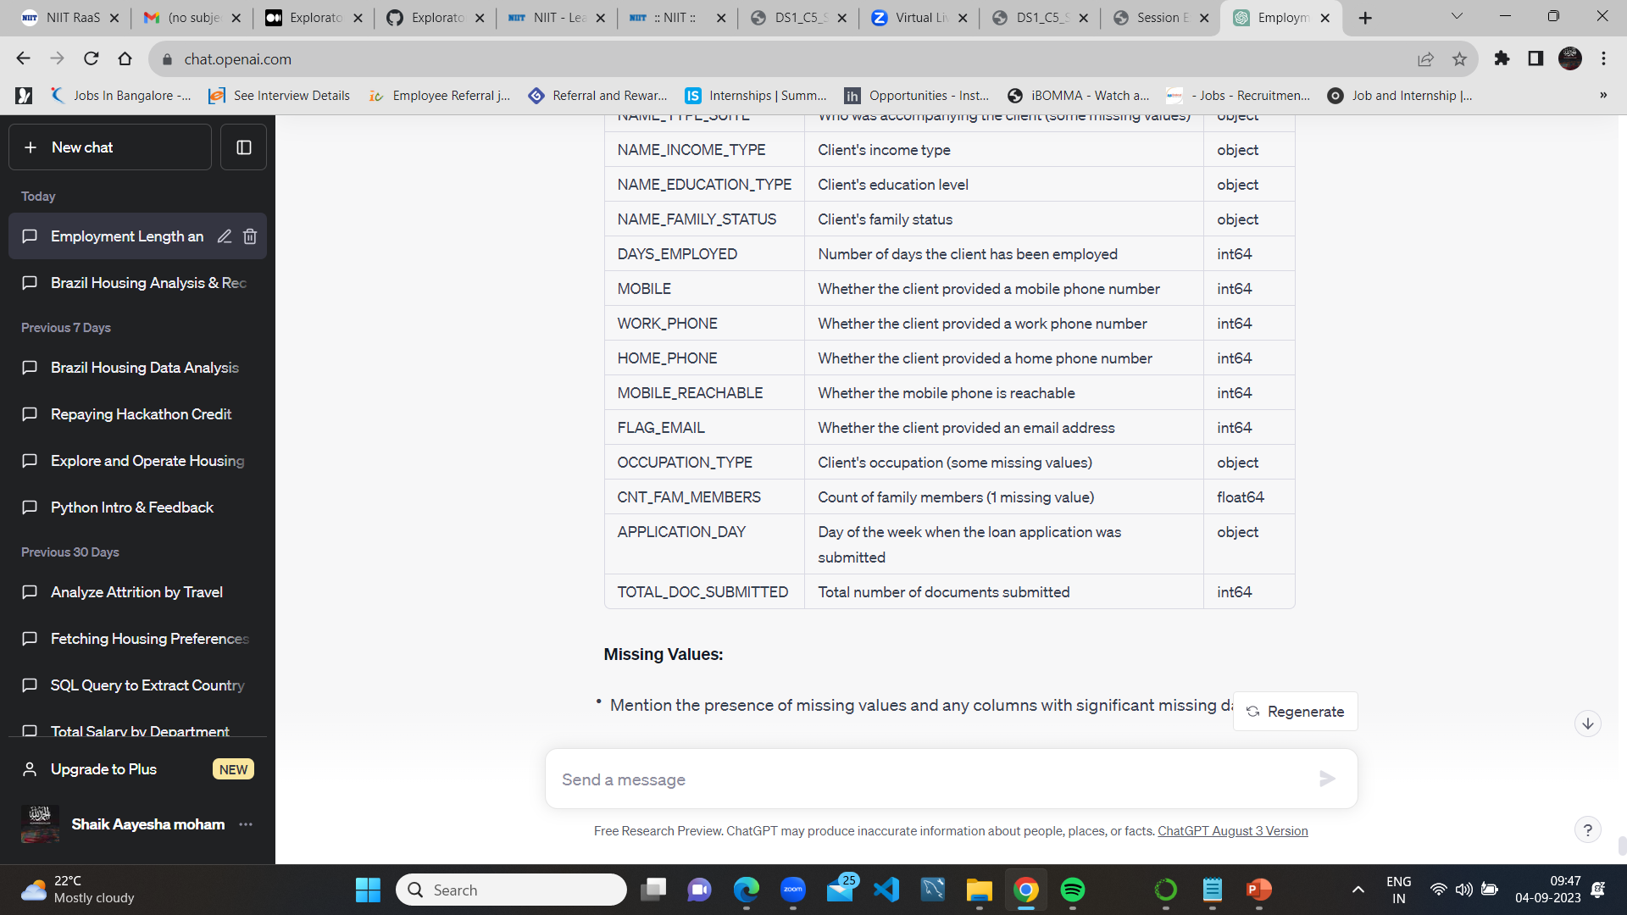
Dataset Columns and Description

Slide 6
3.EXPLORATORY DATA ANALYSIS (EDA)
Exploratory Data Analysis (EDA) is a crucial step in the data analysis process. It involves examining and summarizing the main characteristics of a dataset to uncover initial insights and patterns.
Data Distribution Analysis:
EDA begins by analyzing the distribution of key variables in the dataset to understand the data's central tendencies and variability.

Slide 7
4.HYPOTHESES
What is the distribution of loan approval based on occupation type?
Do clients with a car have a different loan repayment behavior?
Does the income level of clients impact loan approval and repayment?
Which occupation type has the highest average income?
Is there a difference in loan approval for clients with work phones?
Is there a relationship between the length of employment (in days) and loan repayment behavior?
Do clients who provide email addresses have different loan approval rates?
On which day of the week do clients most frequently apply for loans?

Slide 8
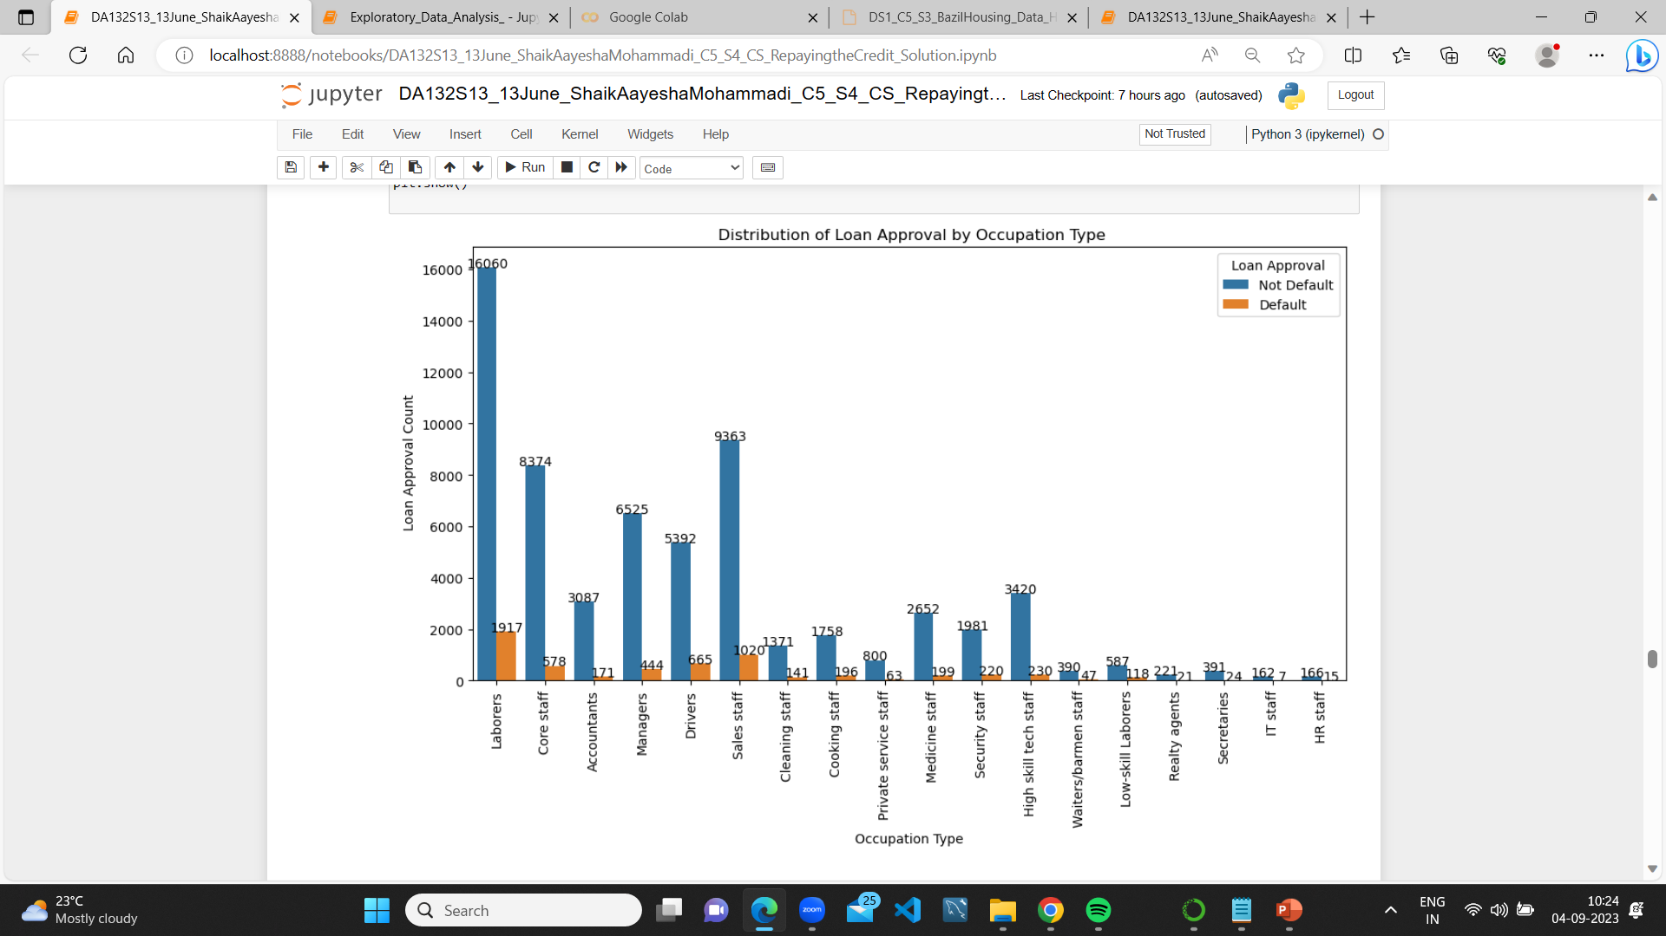
1)What is the distribution of loan approval based on occupation type?
Laborers are the most common occupation type among loan applicants

Slide 9
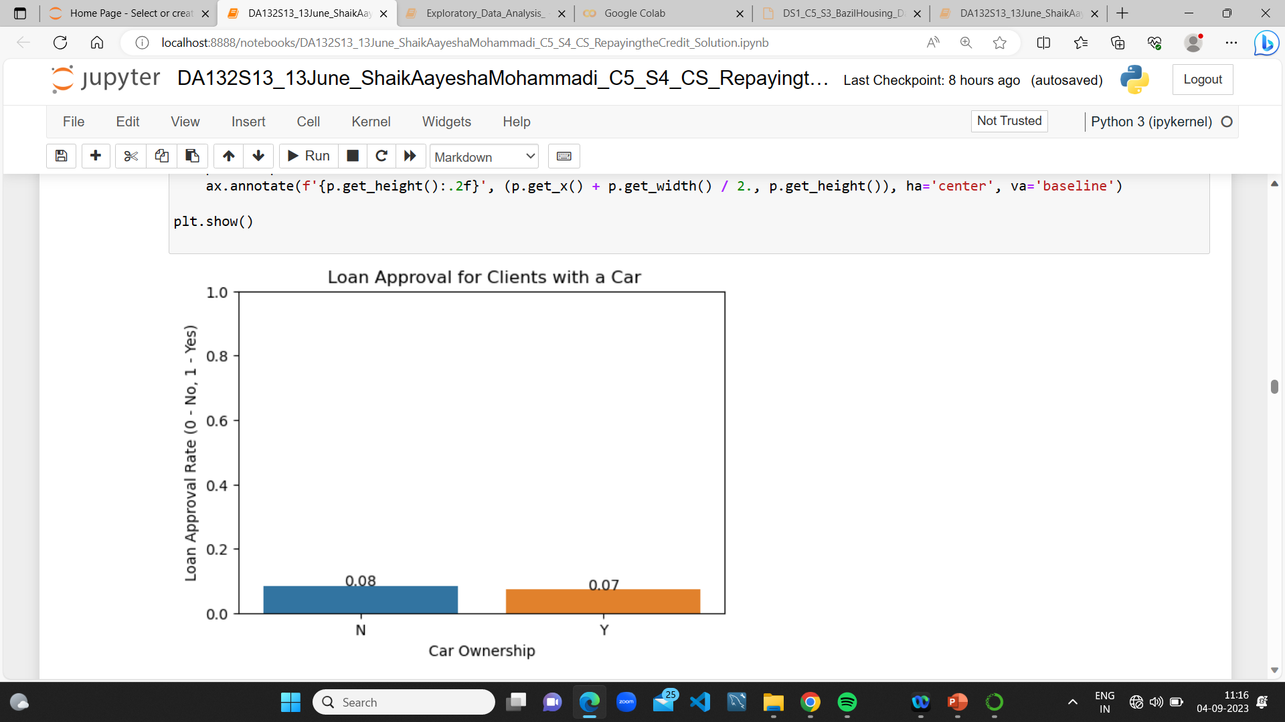
2) Do clients with a car have a different loan repayment behavior?
Clients with a car do not show significant differences in loan repayment behavior.

Slide 10
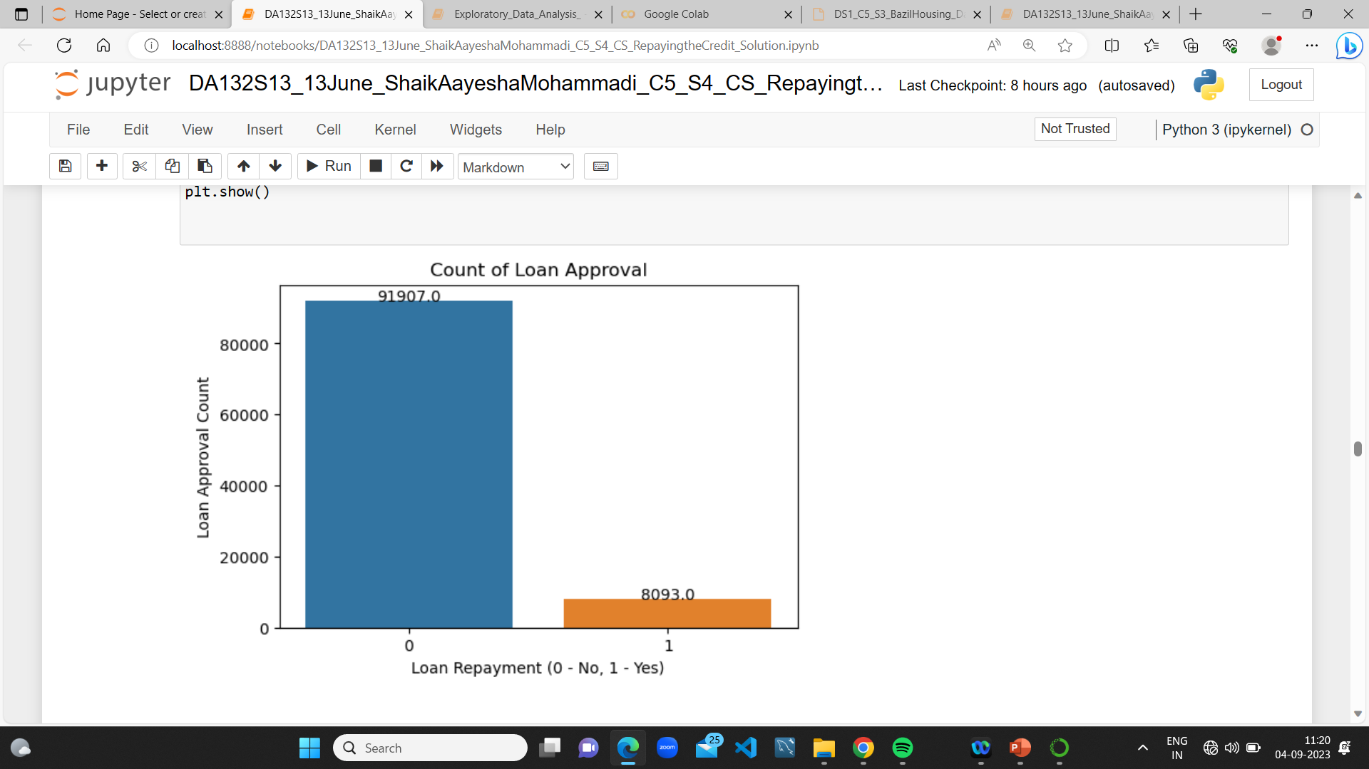
3)Does the income level of clients impact loan approval and repayment?
Clients with higher income levels tend to have a higher probability of loan approval and repayment.

Slide 11
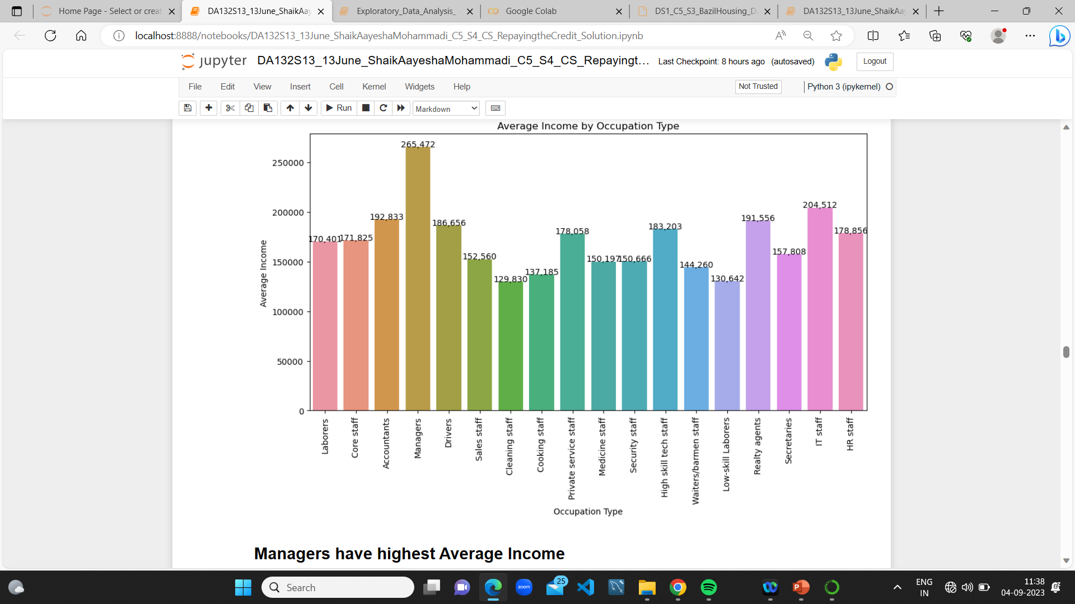
4) Which occupation type has the highest average income?
Managers have highest Average Income

Slide 12
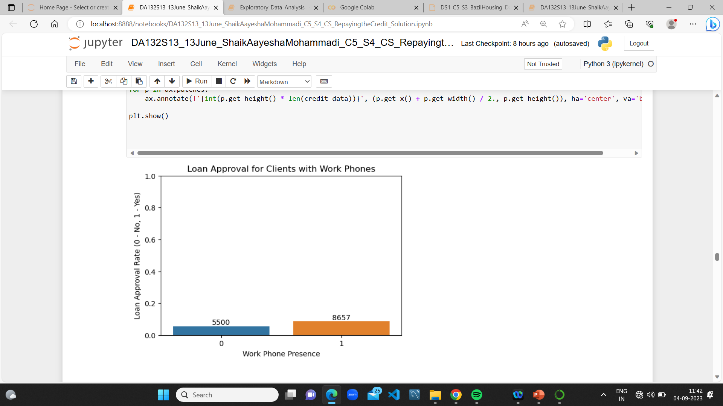
5) Is there a difference in loan approval for clients with work phones?
Clients who provide work phone numbers tend to have higher loan approval rates.

Slide 13
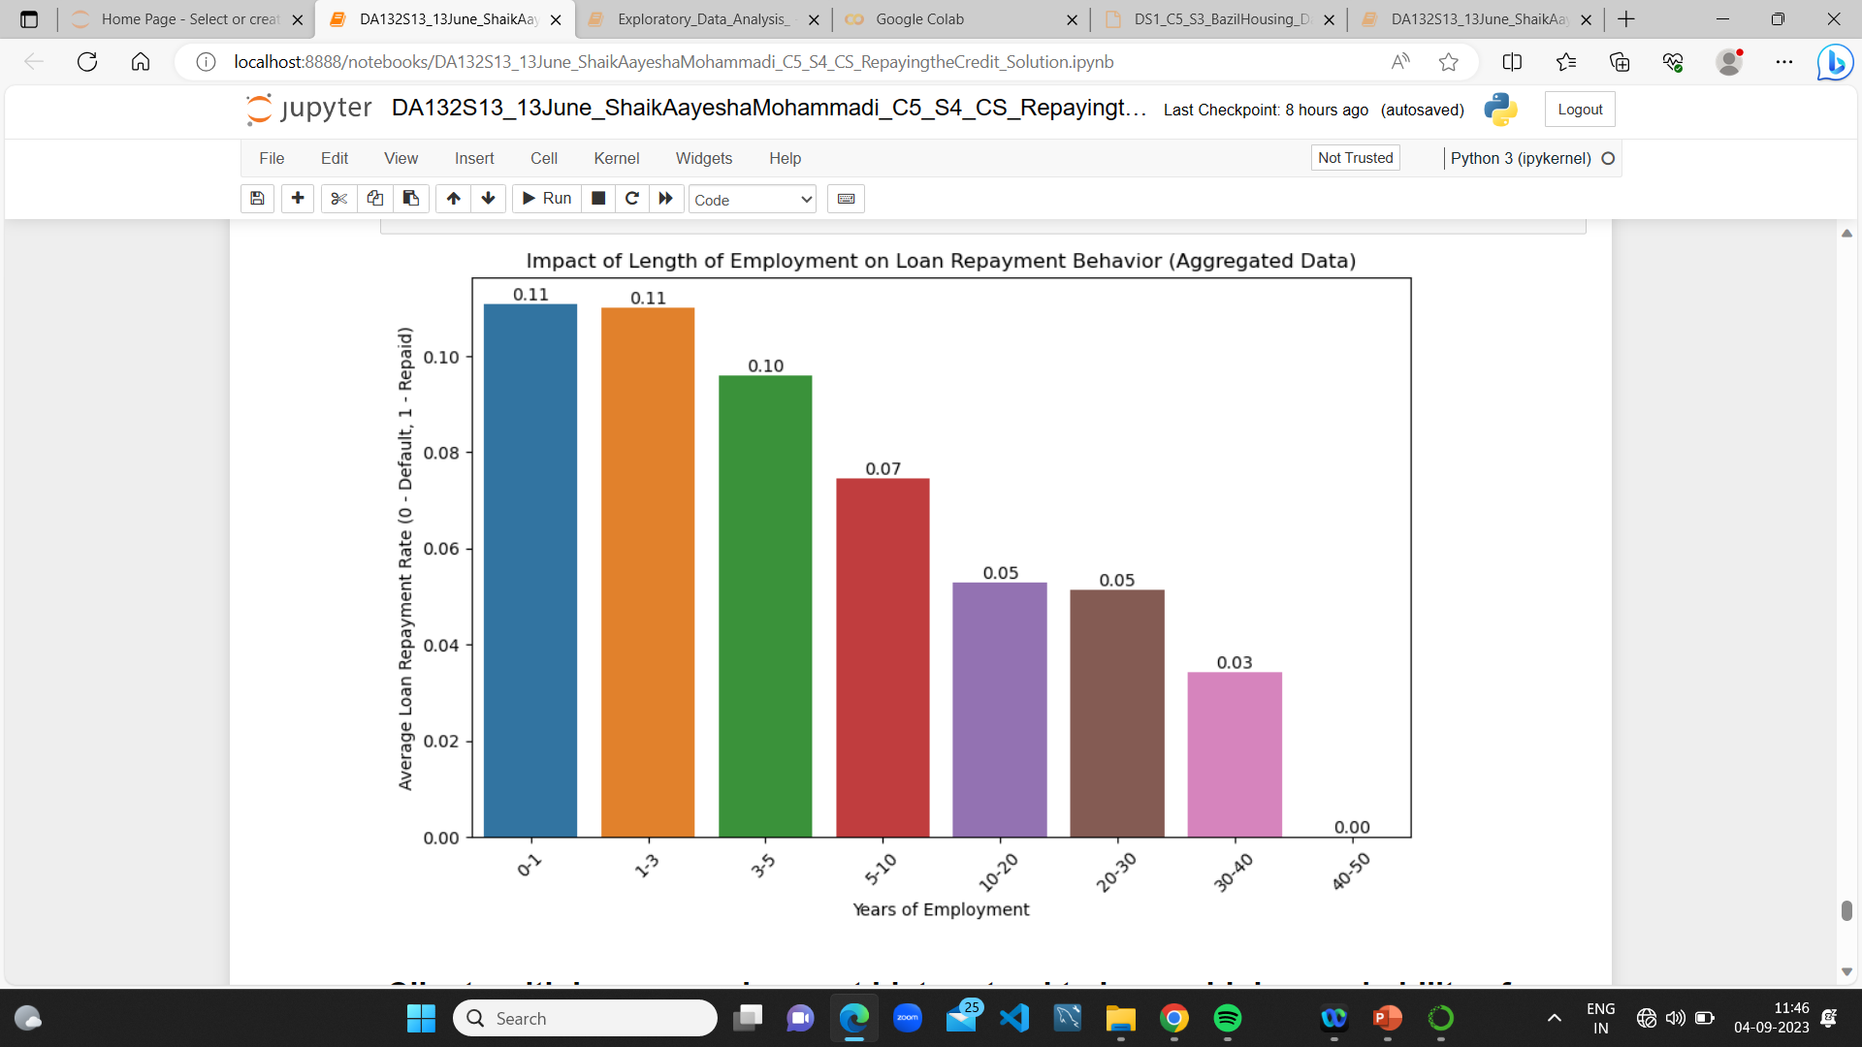
6) Is there a relationship between the length of employment (in days) and loan repayment behavior?
Clients with longer employment history tend to have a higher probability of loan approval and repayment

Slide 14
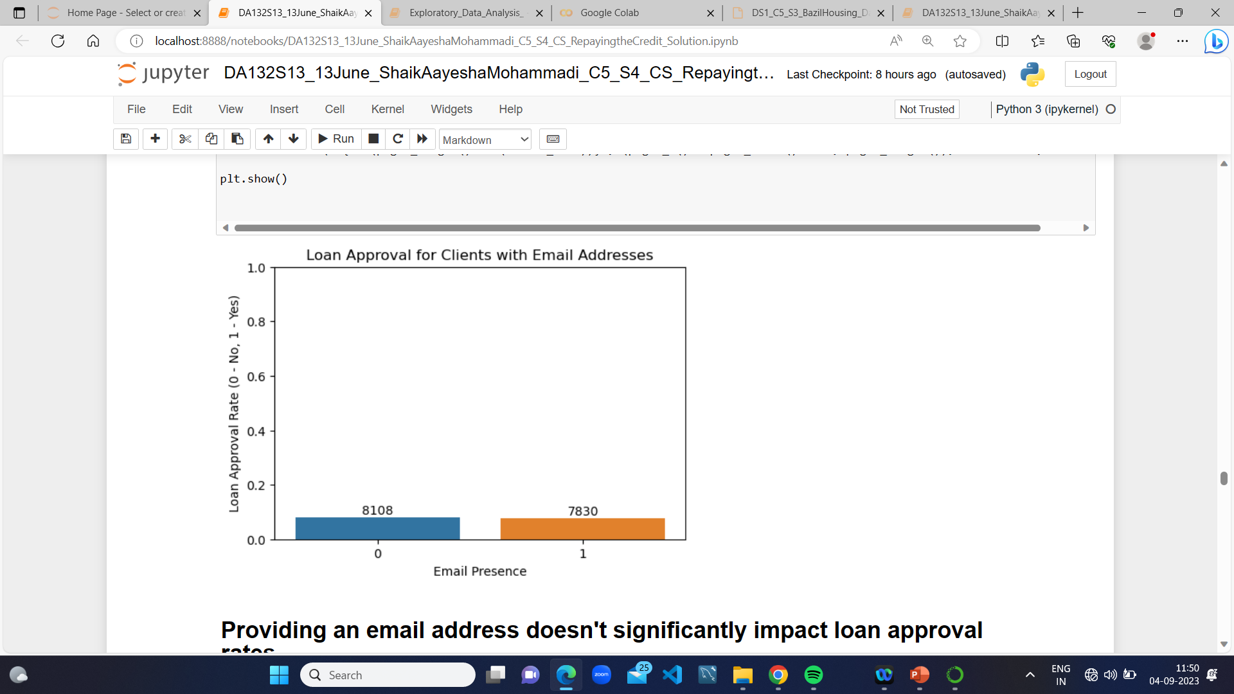
7) Do clients who provide email addresses have different loan approval rates?
Providing an email address doesn't significantly impact loan approval rates.

Slide 15
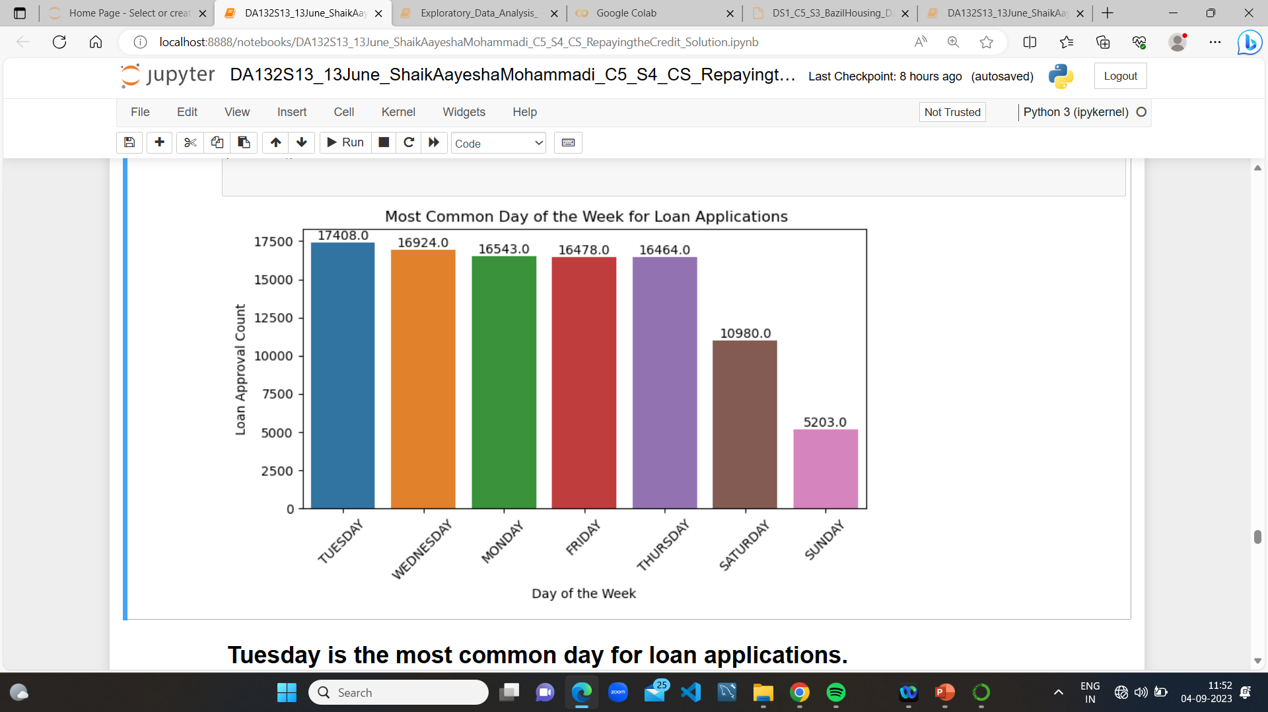
8)On which day of the week do clients most frequently apply for loans?
Tuesday is the most common day for loan applications.

Slide 16
6.INSIGHTS
1. Gender: The majority of loan applicants are female, but gender alone may not be a strong predictor of loan repayment behavior.
2. Car Ownership: Owning a car does not significantly impact loan repayment behavior, indicating it may not be a strong predictor of default risk.
3. Number of Children: The number of children does not strongly correlate with loan repayment status, suggesting it may not be a primary factor in default risk assessment.
4. Income Level: Higher income levels are associated with higher loan approval and repayment rates, making it a key indicator of creditworthiness.
5. Occupation Type: Managers, with the highest average income, might pose lower default risks, implying occupation type can be relevant in assessing creditworthiness.
6. Contact Information: Providing valid and reachable contact information, especially work phone numbers, is essential for higher loan approval rates and effective communication.
7. Contract Type:Different contract types can affect loan repayment behavior, indicating a need to understand the behavior associated with each type for improved risk assessment.
8. Education Level: Higher education levels are linked to higher loan approval and repayment rates, making education level a potential predictor of default risk.
9. Family Status: Certain family statuses are associated with higher loan approval and repayment rates, suggesting family status can be a relevant factor in credit assessments.
10. Length of Employment: Longer employment history is associated with higher loan approval and repayment rates, so prioritize applicants with longer job tenures.

Slide 17
ADVANTAGES
1. Uncover patterns and trends.
2. Make accurate predictions.
3. Gain insights from large amounts of data.
4. Identify relationships between variables.
5. Optimize processes and solve complex problems.
6. Make informed decisions based on evidence.

Slide 18
DISADVANTAGES
Complexity and Expertise
Data Quality Issues
Changing Market Dynamics
Limited Scope
Ethical considerations

Slide 19
APPLICATIONS
1. Business Analytics
2. Healthcare Data Analysis
3. Financial Data Analysis
4. Sports Analytics
5. Marketing Research
6. Social Sciences Research
7. Environmental Data Analysis
8. Manufacturing Process Optimization
9. Education Data Analysis
10. Transportation Analytics

Slide 20
CONCLUSION
The analysis of credit data highlights key factors affecting loan repayment behavior. While certain factors like gender and car ownership have limited influence, others hold significant importance. Income level emerges as a critical determinant, with higher income applicants exhibiting better loan approval and repayment rates.
Occupation type also plays a role, particularly for managerial positions with their higher average incomes. Contact information, especially valid phone numbers, is vital for effective communication and risk reduction.
Family status and education level provide additional context for credit assessment. Longer employment history is a positive indicator, emphasizing employment stability.
To reduce default risk and enhance lending decisions, the institution should adopt a holistic approach considering income, employment, occupation, contact details, education, and family status. This approach will improve credit decision-making, mitigate default risk, and strengthen financial stability.

Slide 21
THANK YOU

